Slide 1


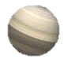
Interplanetary Communication
J103 신승현

Slide 2
Contents
What is it?
Why we need it?
How to use it?
Current Technology.
Future Technology.

Slide 3
1. What is it?
data
data
data

Slide 4


1. What is it?
talk

Slide 5


1. What is it?
< PAN >
data
data
data
data

Slide 6


1. What is it?
< LAN >
data
data
data

Slide 7


1. What is it?
< WAN >

Slide 8
1. What is it?
data
data
data
< Interplanetary Communication >

Slide 9

2. Why we need it?
Interplanetary
Communication
Space Science
/
Space Exploration
$$∝$$

Slide 10
2. Why we need it?
Relieve Curiosity
Figure out origin of Universe
Spin-off Technique

Slide 11
3. How to use it?
※ ISSUES
- Station
- Performance
- Reliability

Slide 12
3. How to use it?
※ Solutions
- Radar / Satellite / Space Exploration Robot
- X Band / FSO
- DTN / Error Recovery

Slide 13
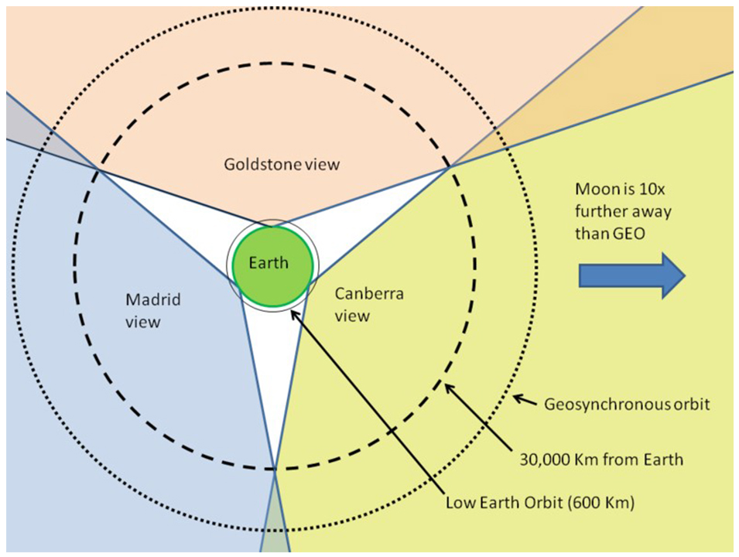
3. How to use it?
- Radar

Slide 14
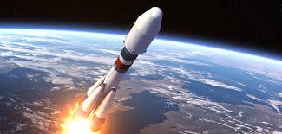
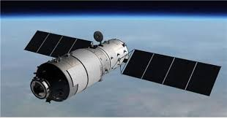
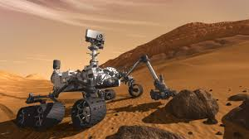
3. How to use it?
- Satellite / Space Exploration Robot

Slide 15
3. How to use it?
Division | IEEE Classification
HF | 3 ~ 30 MHz
VHF | 30 ~ 300 MHz
UHF | 300 ~ 1000 MHz
L Band | 1 ~ 2 GHz
S Band | 2 ~ 4 GHz
C Band | 4 ~ 8 GHz
X Band | 8 ~ 12 GHz
Ku Band | 12 ~ 18 GHz
K Band | 18 ~ 27 GHz
Ka Band | 27 ~ 40 GHz
V Band | 40 ~ 75 GHz
W Band | 75 ~ 110 GHz
- X Band

Slide 16
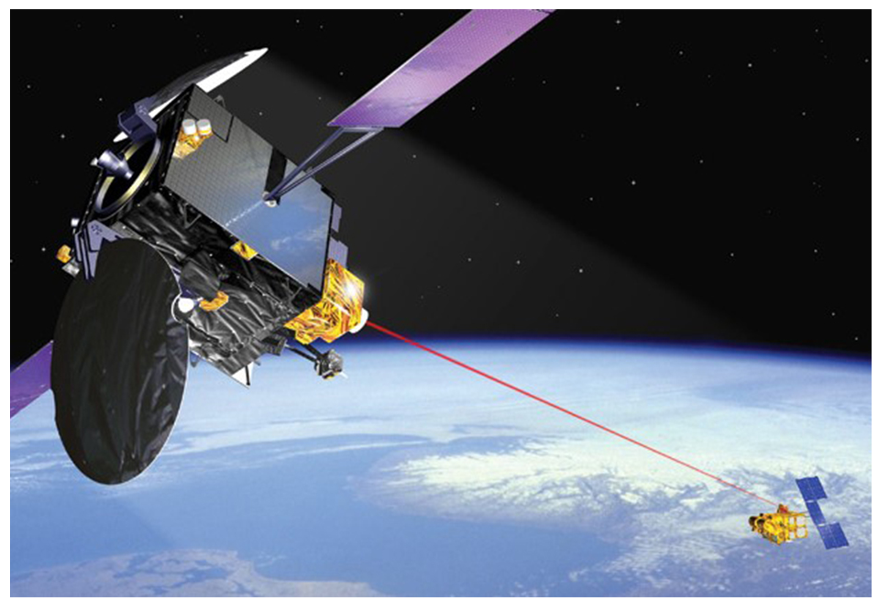
3. How to use it?
- FSO / Free Space Optical communication

Slide 17
3. How to use it?
- DTN / Delay, Disruption Tolerant Network
- Error Recovery / Hamming code, Parity bit

Slide 18
4. Current Technology
Satellite
X Band
DTN / Error Recovery

Slide 19
5. Future Technology
Planet Station
FSO

